Slide 3
It’s a Question About Knowledge
What kind of Job do you see doing social work-wise?
How many of you plan on getting your Master’s in Social Work (or other degree)?
What do you think case management is?

Slide 4
Overview
About
Who’s Jacob?
CM @ TCCH
Overview of CM
Micro
Practical Exp.
CM Skills
Macro
Practical Exp.
Environmental Change

Slide 5
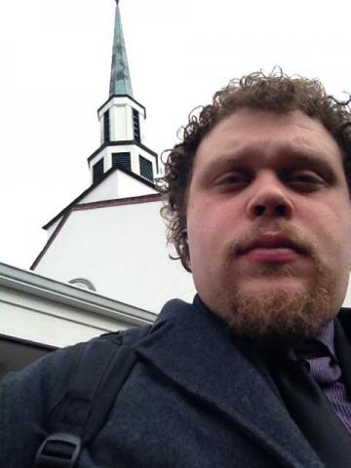
Who’s Jacob
Educational Experience
Work Experience
Outside Practice

Slide 6
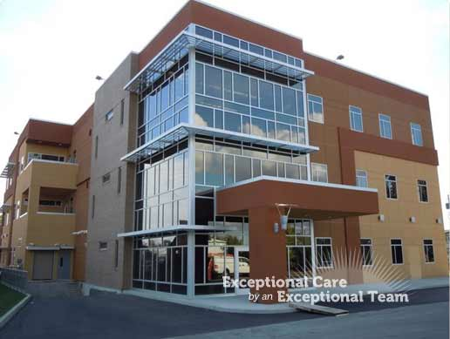
CM @ TCCH
Tri-Cities Community Health Overview
Cliental Demographical Information

Slide 7
CM Overview
What fields have case management in them?
Multi-axial diagnosis and case management
Psychoeducation
Resource connections / stablization
Case coordination
Micro || Mezzo || Macro

Slide 8
Practical Experience
10 Activities I did this last week
In an office or in the community or home?
Notes:
Met with clients who showed up unscheduled at my office
When to a clients home and discussed community resources / made phone calls
Participated in a day long training
Took a client to pick up their prescription
Participated in a 3 Rivers Family Planning meeting
Went to DSHS with a client (3 times)
Celebrated because chronically homeless / mentally ill client got into an apartment
Phone calls, emails, paperwork, coordinating with other clinicians / supervisor
Spoke to DSHS Worker, CPS Worker, Wraparound Care Coordinator, Shelter Staff, Dog Kennel Owner, CAC worker… probably others
Drove hundreds of miles

Slide 9
CM Skills
Professional connections
Knowledgeable about resources
Micro skills
Therapeutic techniques
Opportunistic bent

Slide 10
Practical Experience
Pasco Discovery Coalition
Children’s Alliance
VOICES
Generalists Intervention Model

Slide 11
Environmental Change

Slide 12
Questions?
Ask questions
Follow up later: jacob.r.campbell@gmail.com
Download presentation at http://jacobrcampbell.com/resources

